Slide 1

QUORA QUESTION PAIR SIMILARITY
Using ML, NLP , MLOPS
Guided by Innomatics Research Labs:
Sandhya
Abhilash Patel Routhu
Presented by:
Avinash Durugkar
Cinthiya M
Chekuri Nikhil
Amankumar singh
Mani Teja
Kevin Dausi

Slide 2
TABLE OF CONTENTS
Architecture
Step By Step Procedure and Observation
Brief Introduction
Business problem
Problem statements
Perform Exploratory Data
Apply Text Pre-Processing
Applying NLP-techniques
Model building
Experiment Tracking and Model Management using MLFlow and Workflow Orchestration using Prefect

Slide 3
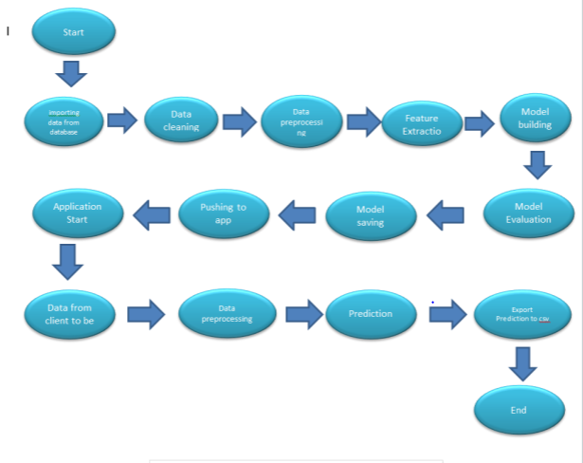
ARCHITECTURE

Slide 4
PROCEDURE AND OBSERVATION
1. Exploratory Data Analysis:
First we did Exploratory Data Analysis on "train.csv" data in which we performed such as finding number of different questions, checking for duplicates, number of occurence of questions etc.
2. Feature extraction:
Performed some feature extraction like fuzz ratio, fuzz partial ration, common word share etc.
3. Visualisation techniques:
After performing feature extraction I applied some visualization techniques such as pair-plot, violin plot, TSNE, etc.
4. Tokenizer: TFIDF Weighted W2V:
Next, Peformed TFIDF Weighted W2V vectorizer on pair of questions dataset and then merged each TFIDF Weighted W2V vectors to our advanced features set and Basic Feature Set.
Peformed Simple TFIDF vectorizer on pair of questions dataset and then merged each TFIDF vectors to our advanced features set and Basic Feature Set
5. Applied Machine learning algorithm:
In the next step, Applied some Machine learning algorithm such as logistic regression, Linear SVM and XGBoost Algorithm and try to found best log-loss Score for both train and test dataset.
6. Tokenizer: Word2Vec Features:
Peformed Word2Vec Features on pair of questions dataset and then merged each Word2Vec Features to our advanced features set and Basic Feature Set.
7. Model building : We train on different models and compare which performed the best
8.Mlops: Automating the entire ML model life cycle from integration to deployment using Mlflow
9. Stramlit: we developed an application using streamlit

Slide 5
INTRODUCTION
On Quora, users can ask questions and receive responses from a variety of users. Though the questions may frequently be formulated differently, the goal remains the same. The ideal scenario is that after a question is posted, Quora would apply some sort of "technique" to identify a part of its current question from the database, and that part would comprise questions that are "similar" to or on the same topic as the newly posted question. Once this selection has been found, Quora will use machine learning to check if any questions in this selected subset are duplicates. Goal : To predict whether a pair of questions are similar or not

Slide 6
BUSINESS PROBLEM
To identify whether a question asked on quora by a new user is a duplicate or a new one.
This helps in saving time and provide good user experience.
Since we identify whether a question is duplicate or not this problem is a supervised learning problem.

Slide 7
PROBLEM STATEMENT
Identify which questions asked on Quora are duplicates of questions that have already been asked. This could be useful to instantly provide answers to questions that have already been answered. We are tasked with predicting whether a pair of questions are duplicates or not

Slide 8






LIBRARIES
Beautiful Soup, Requests
Numpy, Pandas
Matplotlib, Seaborn, Plotly
Sklearn, regex, Tsne, Fuzz

Slide 9
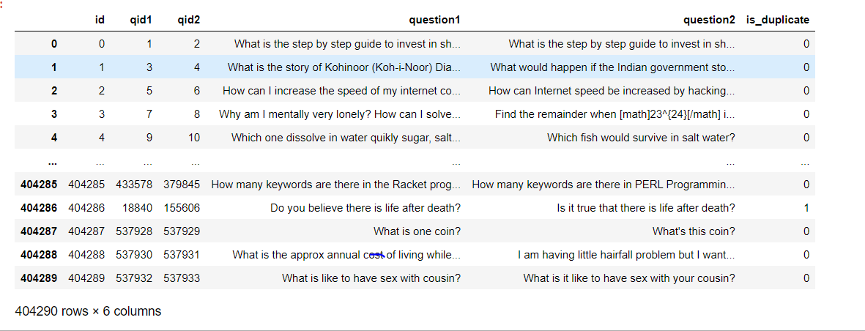
INPUT DATA
Data contains 6 columns id qid1,qid2,question1,question2 and is_duplicate column.
Here question1 and question2 are strings which need to be vectorised

Slide 10
EXPLORATORY DATA ANALYSIS
Exploratory Data Analysis (EDA) is an approach to analyze the data using visual techniques. It is used to discover trends, patterns, or to check assumptions with the help of statistical summary and graphical representations
  Univariate analysis -One variable at a time is Univariate variables
  Bi-Variate analysis -Two variable at a time is Univariate variables:- example is Height and weight
  Multi-Variate analysis - More than two variable is Multi variables

Slide 11
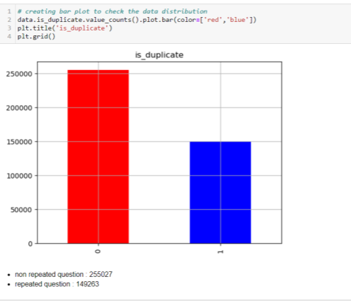
  Bar plot
  Red color represent 250000 Non-repeated questions.
  Blue color represent150000 Repeated questions.

Slide 12
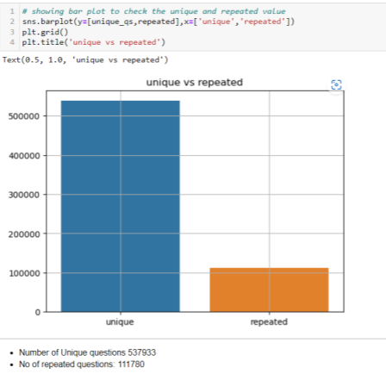
Count plot
  Blue color represent 537933 unique questions.
  Orange color represent 111780 unique questions.

Slide 13
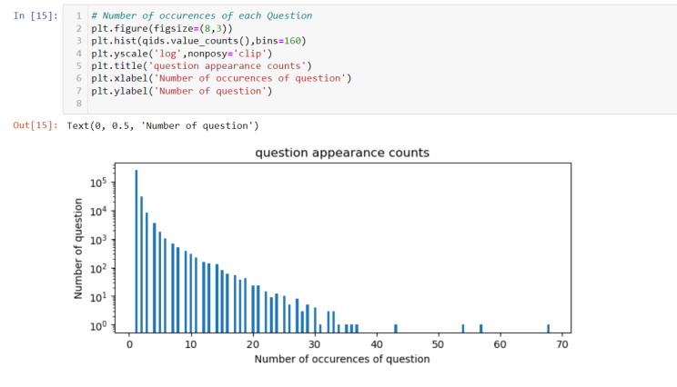
  Histogram
  In this histogram plot we are getting how many question repeated frequently.

Slide 14
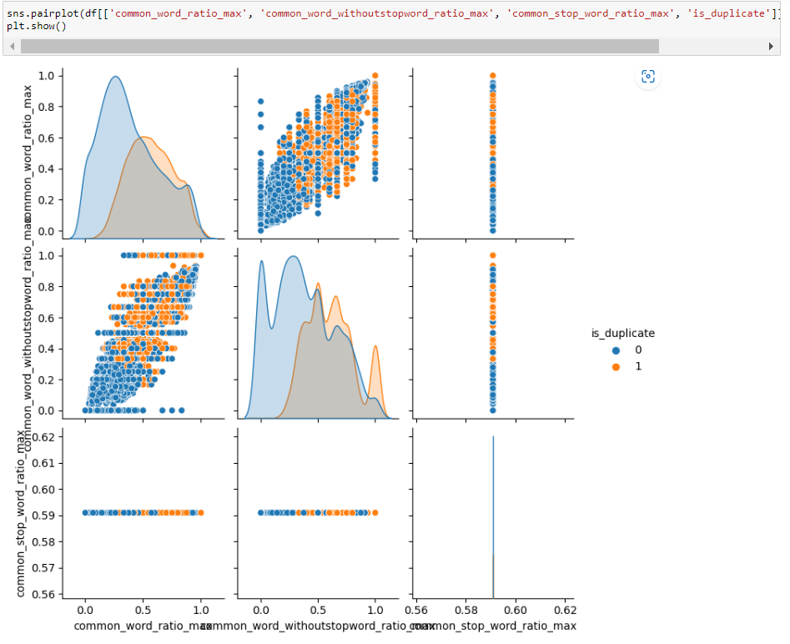
  Pair plot
  The pairplot function creates a grid of Axes such that each variable in data will by shared in the y-axis across a single row and in the x-axis across a single column.
  Bivariate analysis of features we can observe that we can divide duplicate and non duplicate with some of these features with some patterns.

Slide 15
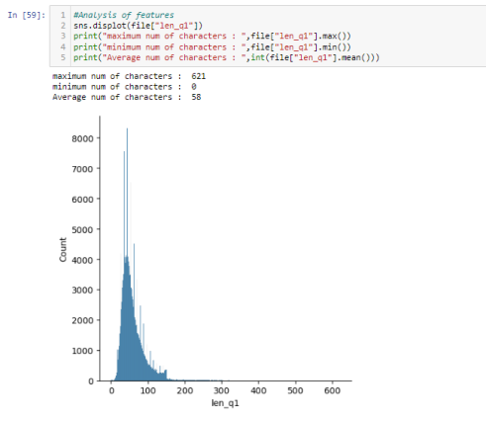
Displot : len_q1
Minimum character = 0
Maximum character = 621
Average number of character = 58

Slide 16
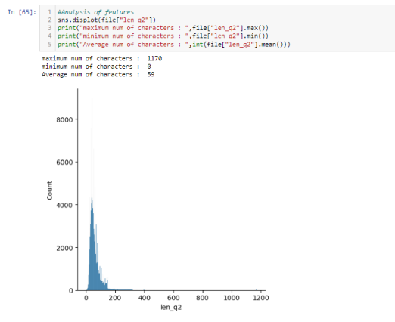
Displot : len_q2
Minimum character = 0
Maximum character = 1170
Average number of character = 59

Slide 17
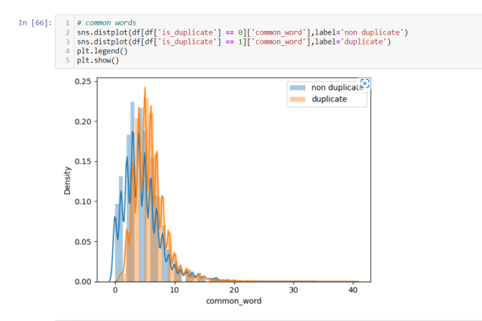
Displot
We can see overlapping portions of Duplicate and Non-duplicate

Slide 18
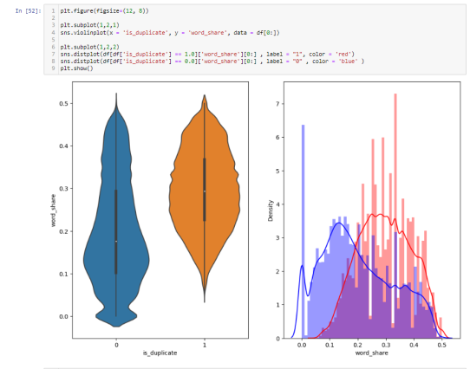
Violinplot & displot:
We can see in violin graph and distance plot , Duplicate and Non -duplicate questions are normally distributed.

Slide 19
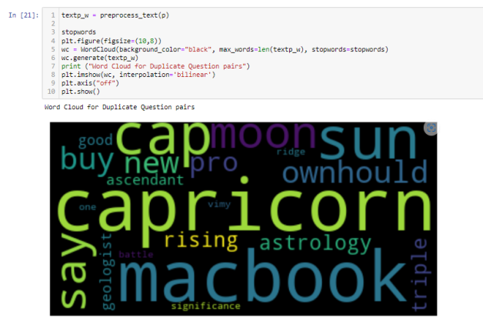
Word cloud
Duplicate questions word cloud

Slide 20
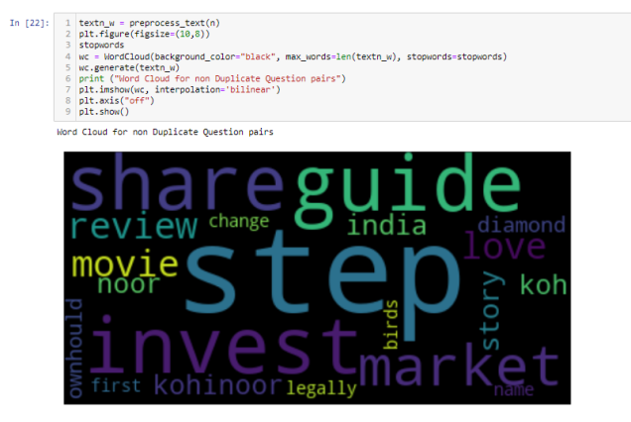
Non-Duplicate questions word cloud

Slide 21
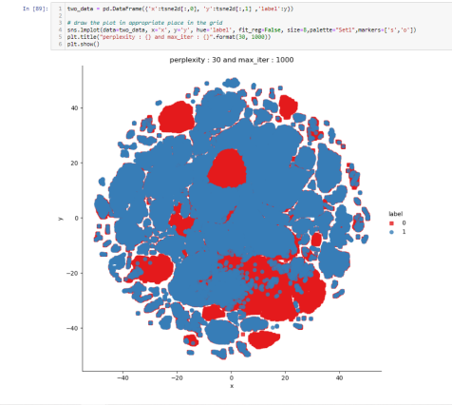
After dimensional reduction we got 2D graph
In this graph we can see the overlapping of duplicate questions

Slide 22
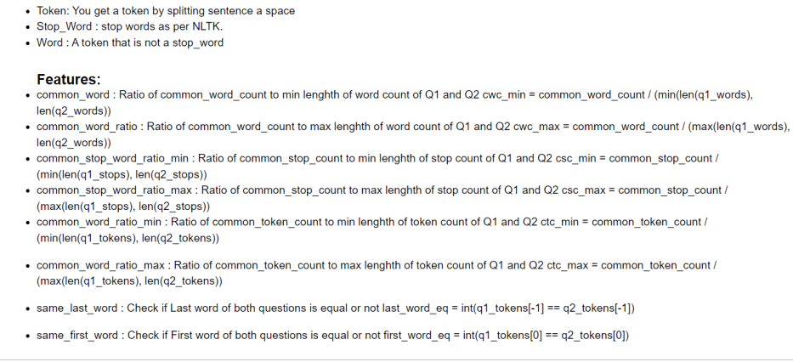
FEATURE EXTRACTION

Slide 23
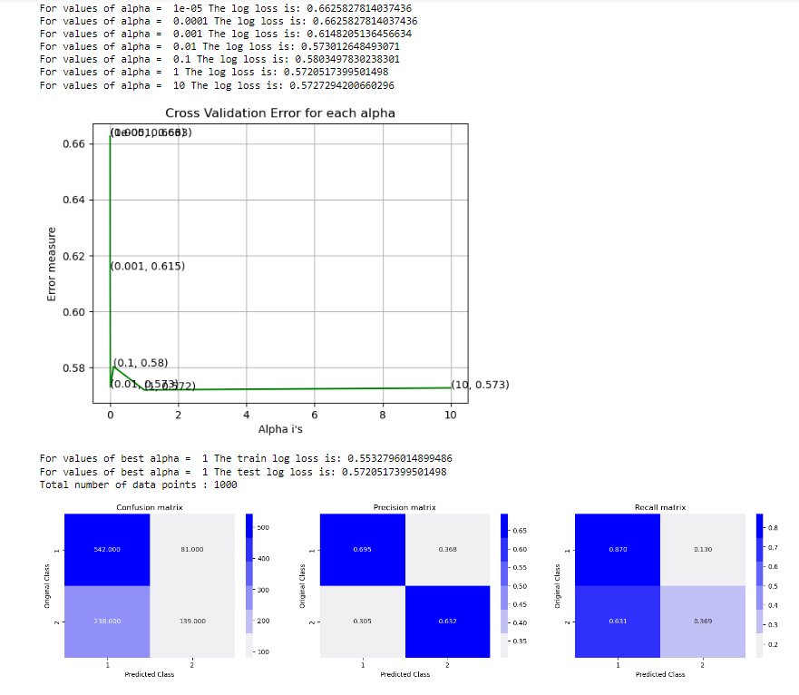
MODLES
  We train on different models and compare which performed the best based on confusion matrix.
Notes:
sentence construction is parallel
meanings are entirely different: the first is a figure of speech involving a metaphor and the second is a literal description.
the identical words in the sentences - flies and like - are used in different grammatical categories.
A computer can be programmed to understand either of these examples, but not to distinguish between them.
to decide whether the sentence is talking about a writing instrument pen or a child's play pen, it would be necessary for a computer to know about the relative sizes of objects in the real world

Slide 24
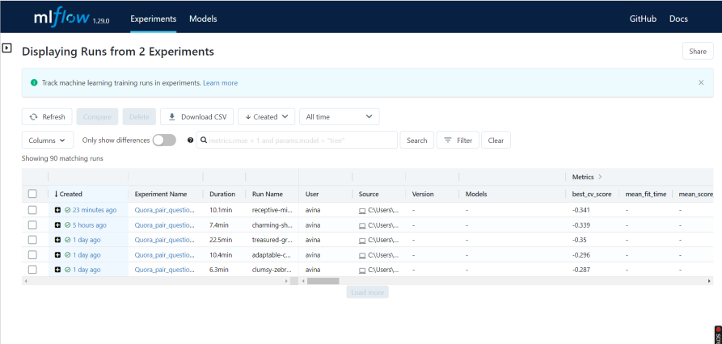
MLFLOW
  We are tracking the ml model life cycle with Mlflow

Slide 25
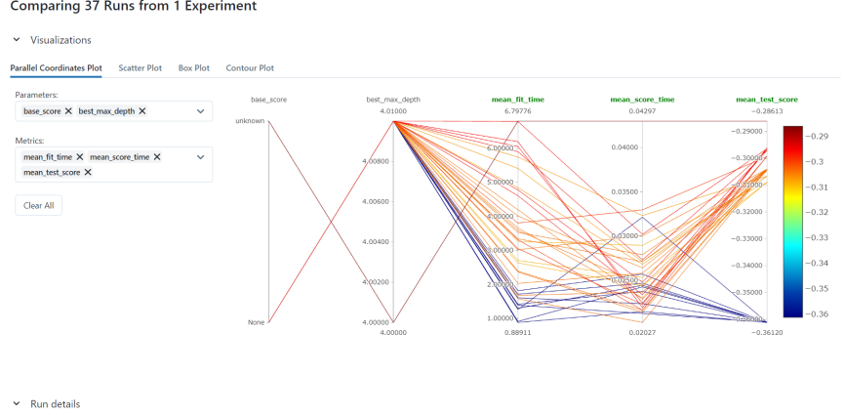

Slide 26
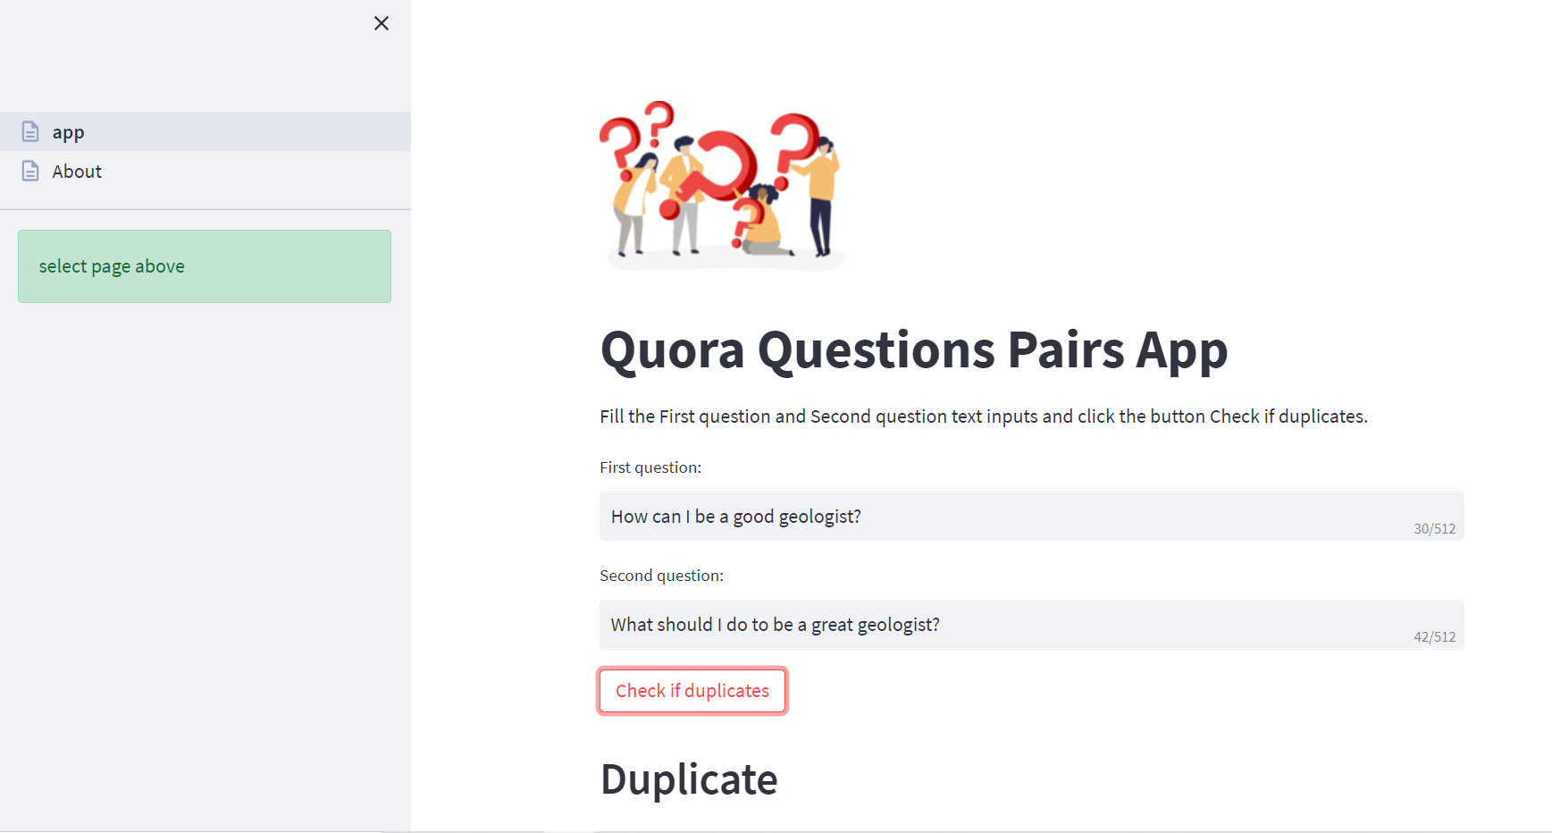
STREAMLIT

Slide 27
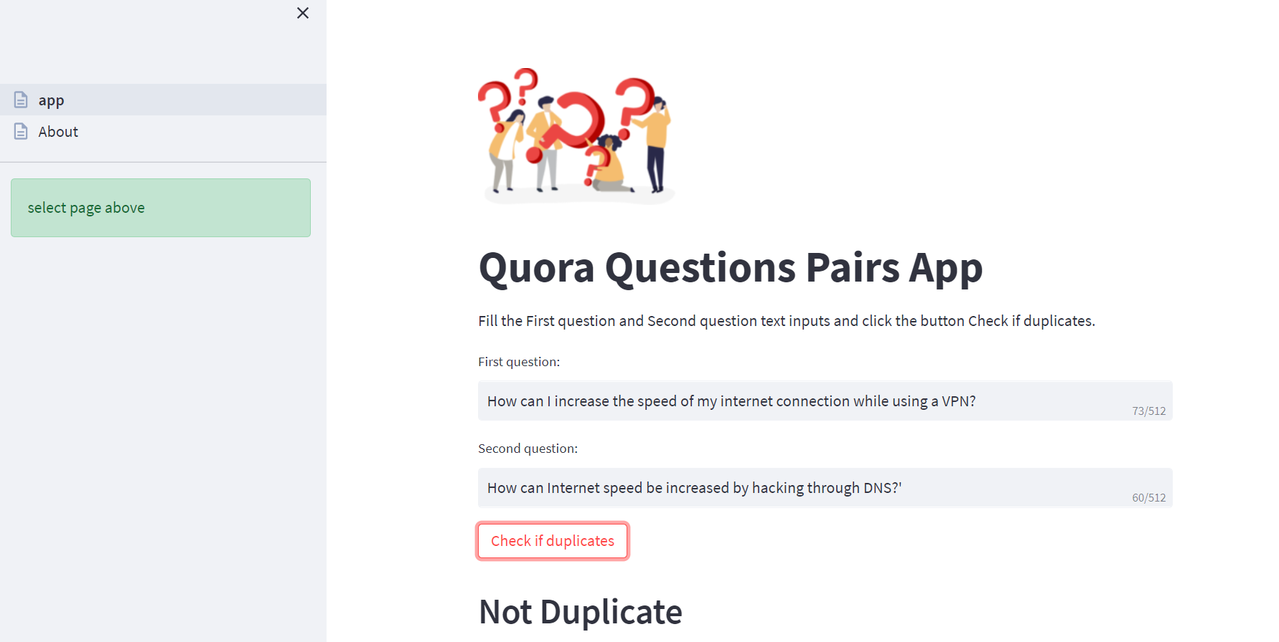

Slide 28
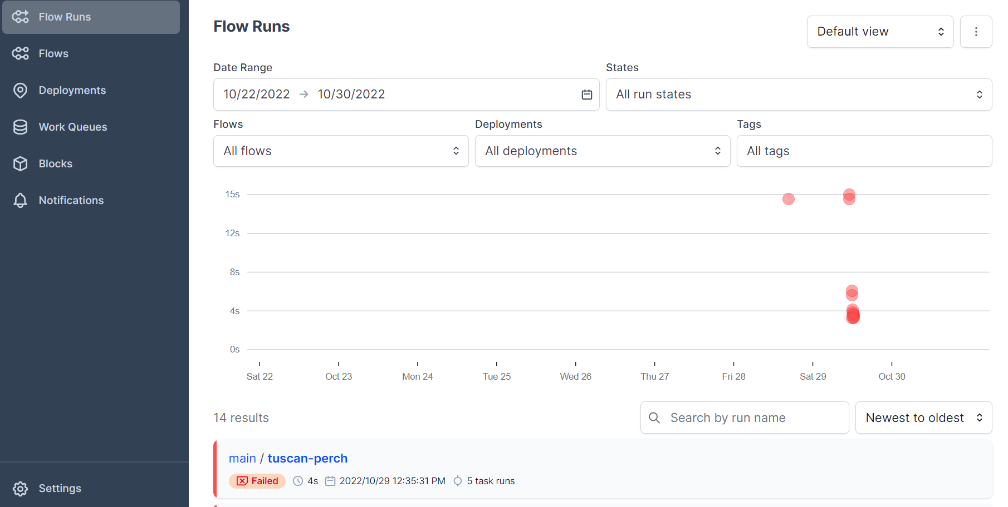
PREFECT

Slide 29


